Slide 1
DEVELOPING AN EVANGELISTIC
CHURCH CULTURE
Aaron Filippone
@AaronFilippone

Slide 2
Building an Evangelistic Church Culture
Focused prayer.

Slide 5
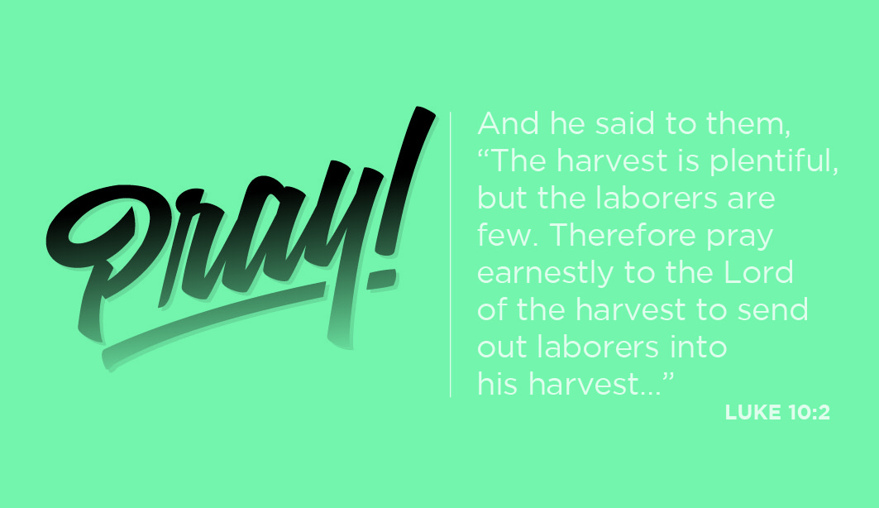
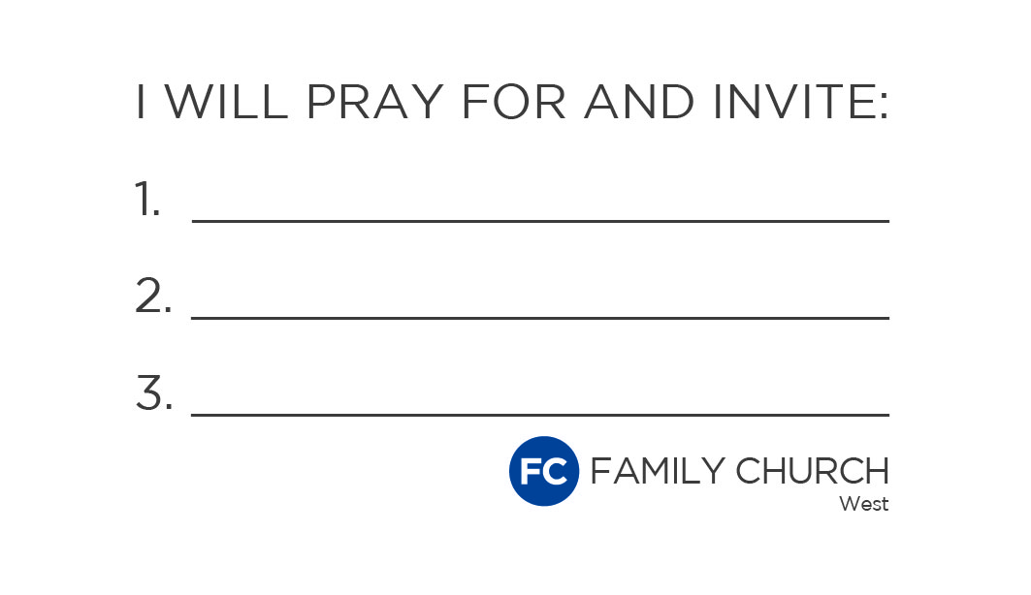

Slide 7
Building an Evangelistic Church Culture
Choose a gospeling tool.

Slide 9
Building an Evangelistic Church Culture
Train your people to use the tool.

Slide 10
Building an Evangelistic Church Culture
Engage with far from God people.

Slide 11
Building an Evangelistic Church Culture
Emphasize rapid obedience.

Slide 12
Building an Evangelistic Church Culture
Coordinate the air war and the ground war.

Slide 13
Building an Evangelistic Church Culture
Create “bottleneck conversations.”

Slide 14
Building an Evangelistic Church Culture
Involve student ministry and children’s ministry.

Slide 15
Building an Evangelistic Church Culture
Collect stories.

Slide 16
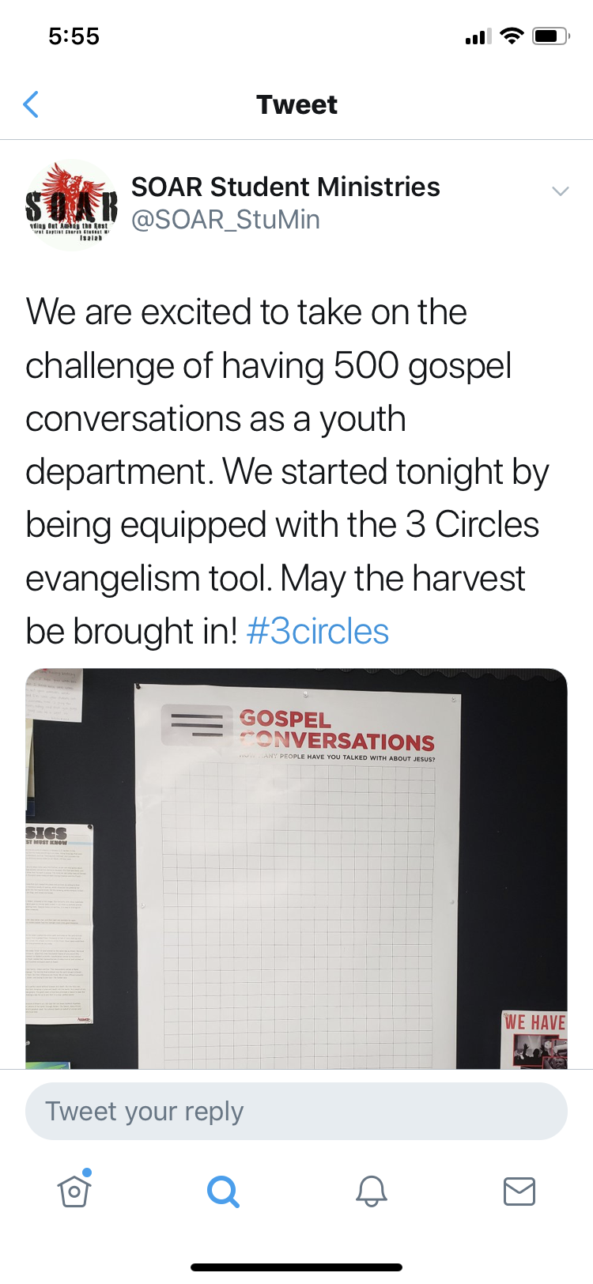

Slide 17
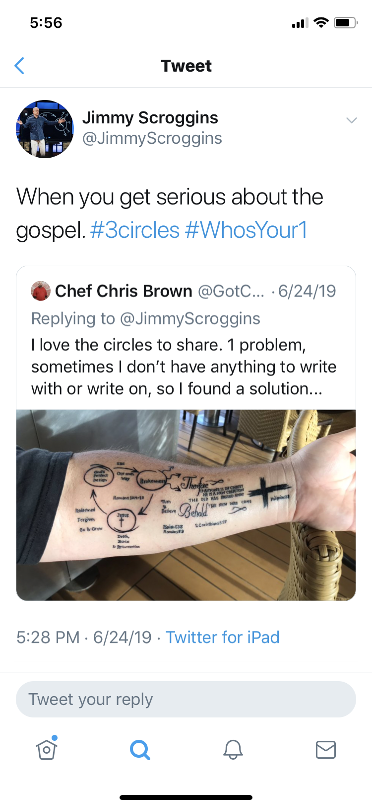

Slide 18
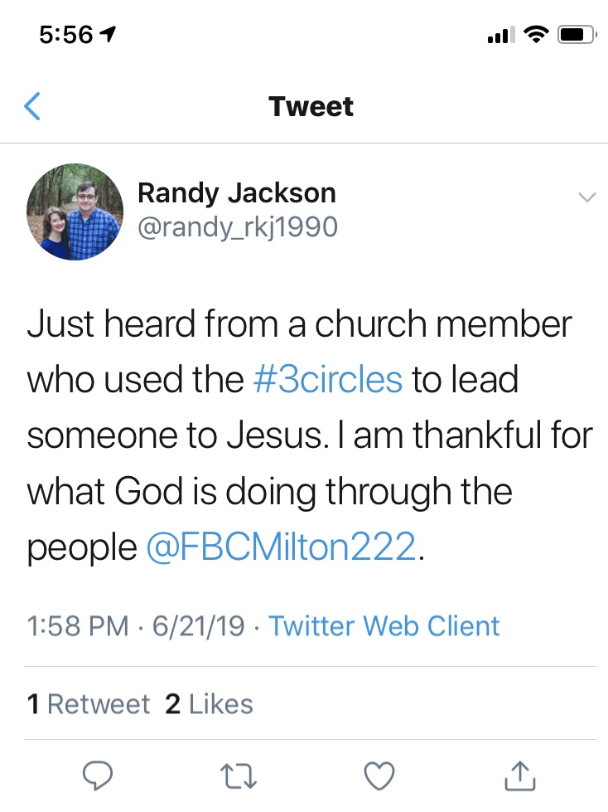

Slide 19


Slide 20
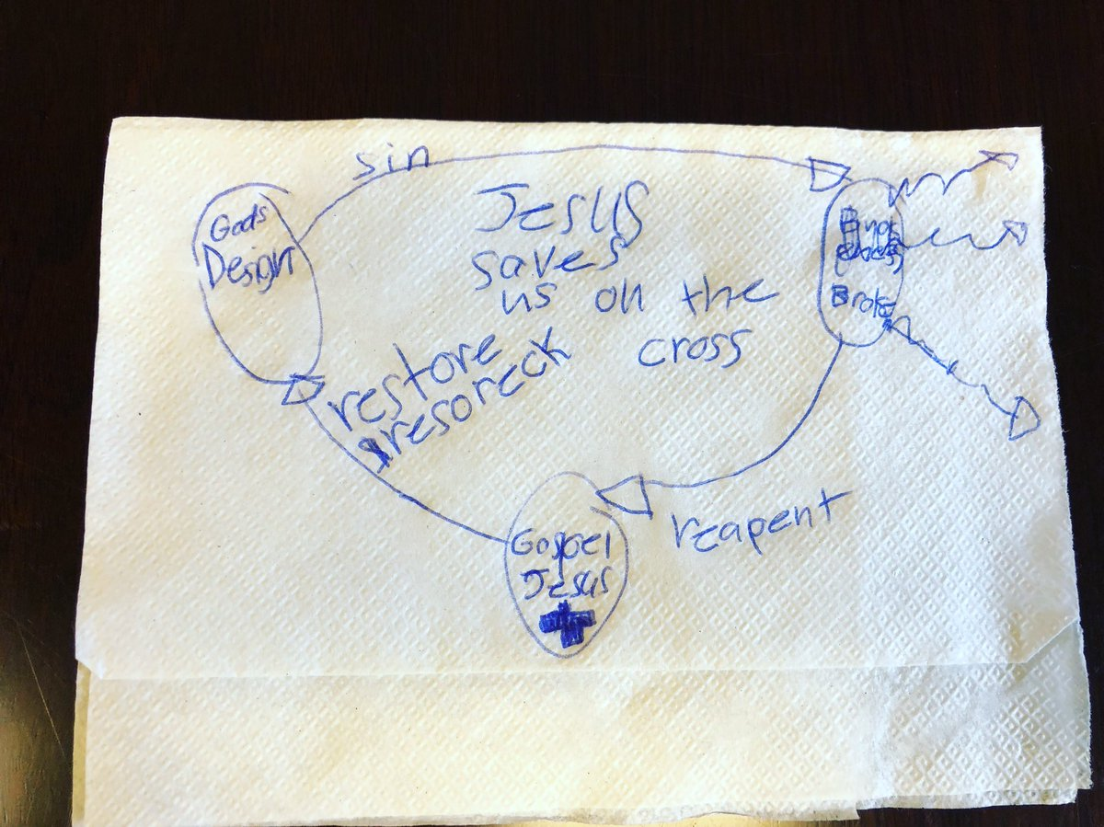
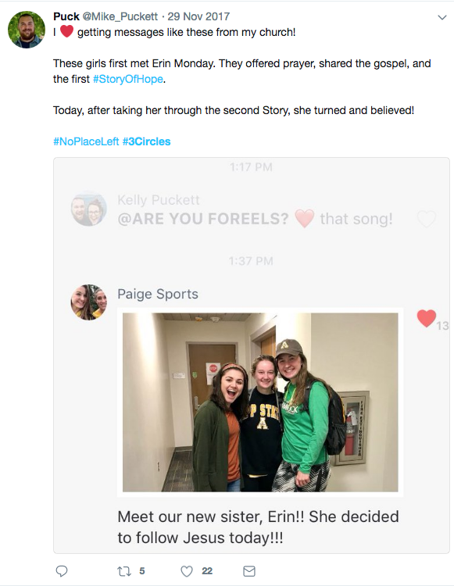

Slide 21
Building an Evangelistic Church Culture
Celebrate God stories.

Slide 22


Slide 23
DEVELOPING AN EVANGELISTIC
CHURCH CULTURE
Aaron Filippone
@AaronFilippone

